Slide 1
Chapter 5
Large and Fast: Exploiting Memory Hierarchy

Slide 2
Memory Technology
§5.1 Introduction
Static RAM (SRAM)
0.5ns – 2.5ns, $2000 – $5000 per GB
Dynamic RAM (DRAM)
50ns – 70ns, $20 – $75 per GB
Magnetic disk
5ms – 20ms, $0.20 – $2 per GB
Ideal memory
Access time of SRAM
Capacity and cost/GB of disk

Slide 3
Principle of Locality
Programs access a small proportion of their address space at any time
Temporal locality
Items accessed recently are likely to be accessed again soon
e.g., instructions in a loop, induction variables
Spatial locality
Items near those accessed recently are likely to be accessed soon
E.g., sequential instruction access, array data

Slide 4
Taking Advantage of Locality
Memory hierarchy
Store everything on disk
Copy recently accessed (and nearby) items from disk to smaller DRAM memory
Main memory
Copy more recently accessed (and nearby) items from DRAM to smaller SRAM memory
Cache memory attached to CPU

Slide 5
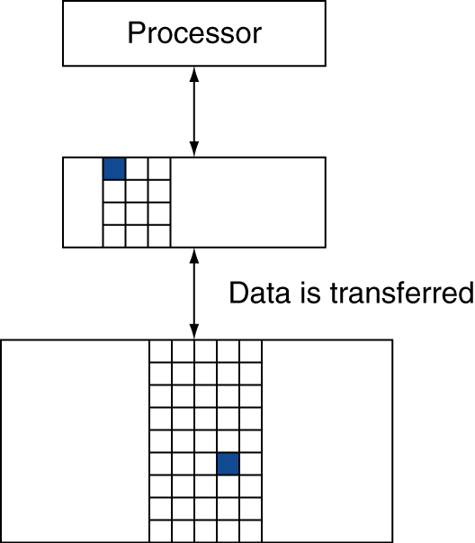
Memory Hierarchy Levels
Block (aka line): unit of copying
May be multiple words
If accessed data is present in upper level
Hit: access satisfied by upper level
Hit ratio: hits/accesses
If accessed data is absent
Miss: block copied from lower level
Time taken: miss penalty
Miss ratio: misses/accesses = 1 – hit ratio
Then accessed data supplied from upper level

Slide 6
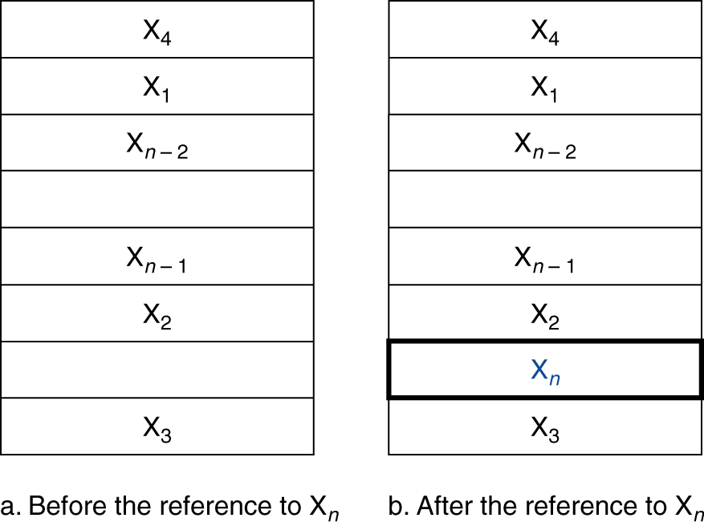
Cache Memory
Cache memory
The level of the memory hierarchy closest to the CPU
Given accesses X₁, …, X_{n–1}, X_{n}
§5.2 The Basics of Caches
How do we know if the data is present?
Where do we look?

Slide 7
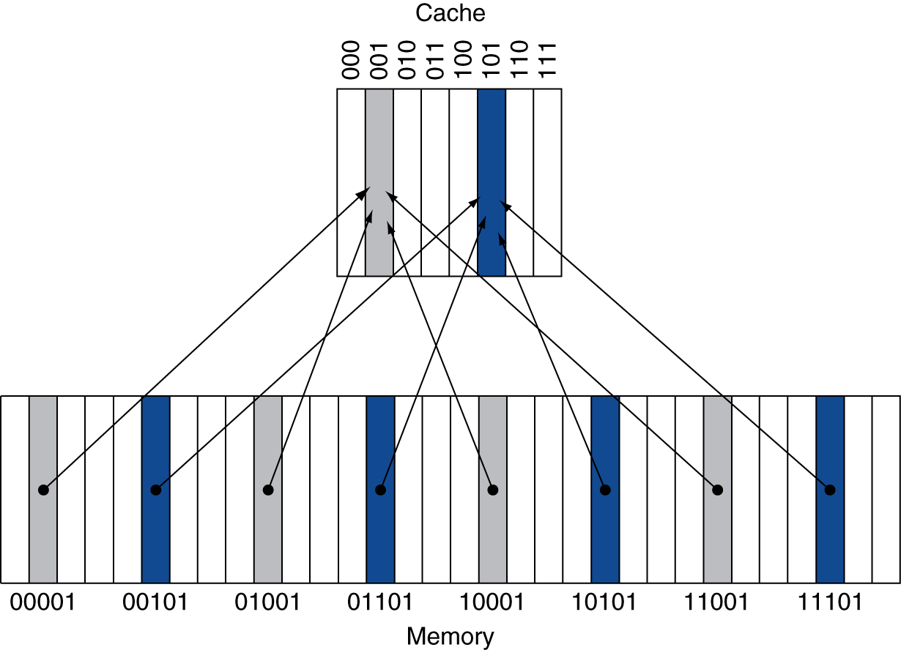
Direct Mapped Cache
Location determined by address
Direct mapped: only one choice
(Block address) modulo (#Blocks in cache)
#Blocks is a power of 2
Use low-order address bits

Slide 8
Tags and Valid Bits
How do we know which particular block is stored in a cache location?
Store block address as well as the data
Actually, only need the high-order bits
Called the tag
What if there is no data in a location?
Valid bit: 1 = present, 0 = not present
Initially 0

Slide 9
Cache Example
8-blocks, 1 word/block, direct mapped
Initial state
Index | V | Tag | Data
000 | N
001 | N
010 | N
011 | N
100 | N
101 | N
110 | N
111 | N

Slide 10
Cache Example
Word addr | Binary addr | Hit/miss | Cache block
22 | 10 110 | Miss | 110
Index | V | Tag | Data
000 | N
001 | N
010 | N
011 | N
100 | N
101 | N
110 | Y | 10 | Mem[10110]
111 | N

Slide 11
Cache Example
Word addr | Binary addr | Hit/miss | Cache block
26 | 11 010 | Miss | 010
Index | V | Tag | Data
000 | N
001 | N
010 | Y | 11 | Mem[11010]
011 | N
100 | N
101 | N
110 | Y | 10 | Mem[10110]
111 | N

Slide 12
Cache Example
Word addr | Binary addr | Hit/miss | Cache block
22 | 10 110 | Hit | 110
26 | 11 010 | Hit | 010
Index | V | Tag | Data
000 | N
001 | N
010 | Y | 11 | Mem[11010]
011 | N
100 | N
101 | N
110 | Y | 10 | Mem[10110]
111 | N

Slide 13
Cache Example
Word addr | Binary addr | Hit/miss | Cache block
16 | 10 000 | Miss | 000
3 | 00 011 | Miss | 011
16 | 10 000 | Hit | 000
Index | V | Tag | Data
000 | Y | 10 | Mem[10000]
001 | N
010 | Y | 11 | Mem[11010]
011 | Y | 00 | Mem[00011]
100 | N
101 | N
110 | Y | 10 | Mem[10110]
111 | N

Slide 14
Cache Example
Word addr | Binary addr | Hit/miss | Cache block
18 | 10 010 | Miss | 010
Index | V | Tag | Data
000 | Y | 10 | Mem[10000]
001 | N
010 | Y | 10 | Mem[10010]
011 | Y | 00 | Mem[00011]
100 | N
101 | N
110 | Y | 10 | Mem[10110]
111 | N

Slide 15
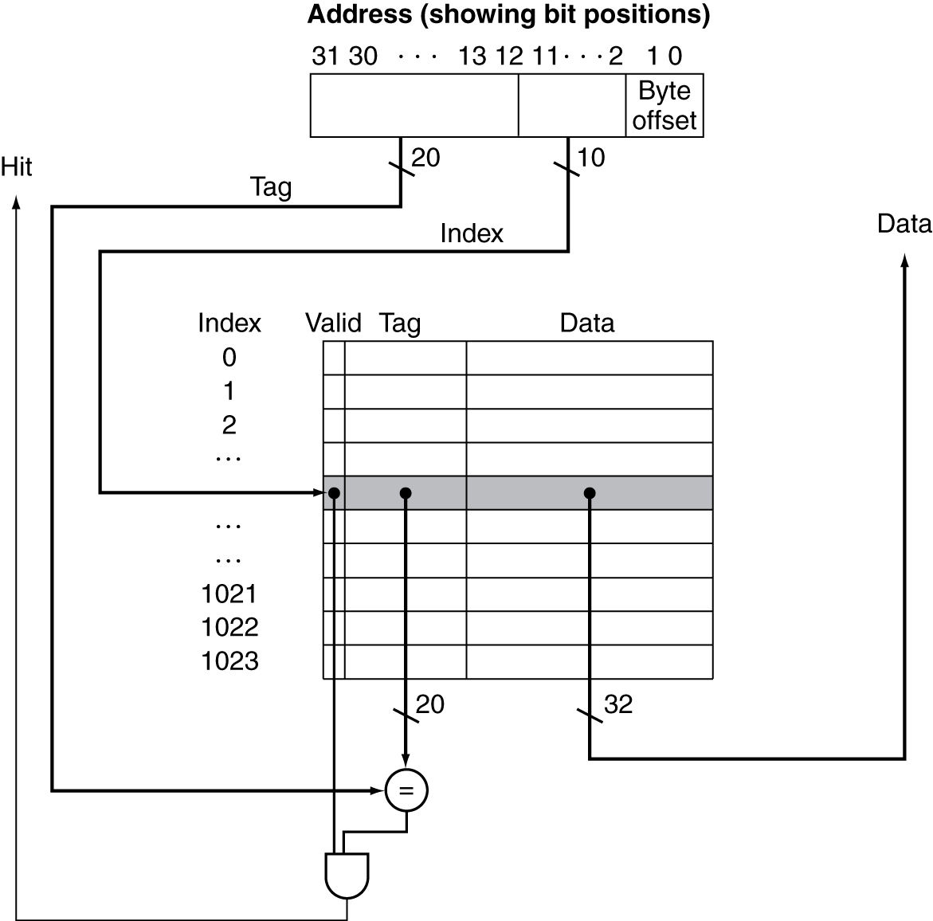
Address Subdivision

Slide 16
Example: Larger Block Size
64 blocks, 16 bytes/block
To what block number does address 1200 map?
Block address = ⎣1200/16⎦ = 75
Block number = 75 modulo 64 = 11
31
10
9
4
3
0
Tag
Index
Offset
22 bits
6 bits
4 bits

Slide 17
Block Size Considerations
Larger blocks should reduce miss rate
Due to spatial locality
But in a fixed-sized cache
Larger blocks ⇒ fewer of them
More competition ⇒ increased miss rate
Larger blocks ⇒ pollution
Larger miss penalty
Can override benefit of reduced miss rate
Early restart and critical-word-first can help

Slide 18
Cache Misses
On cache hit, CPU proceeds normally
On cache miss
Stall the CPU pipeline
Fetch block from next level of hierarchy
Instruction cache miss
Restart instruction fetch
Data cache miss
Complete data access

Slide 19
Write-Through
On data-write hit, could just update the block in cache
But then cache and memory would be inconsistent
Write through: also update memory
But makes writes take longer
e.g., if base CPI = 1, 10% of instructions are stores, write to memory takes 100 cycles
Effective CPI = 1 + 0.1×100 = 11
Solution: write buffer
Holds data waiting to be written to memory
CPU continues immediately
Only stalls on write if write buffer is already full

Slide 20
Write-Back
Alternative: On data-write hit, just update the block in cache
Keep track of whether each block is dirty
When a dirty block is replaced
Write it back to memory
Can use a write buffer to allow replacing block to be read first

Slide 21
Write Allocation
What should happen on a write miss?
Alternatives for write-through
Allocate on miss: fetch the block
Write around: don’t fetch the block
Since programs often write a whole block before reading it (e.g., initialization)
For write-back
Usually fetch the block

Slide 22
Example: Intrinsity FastMATH
Embedded MIPS processor
12-stage pipeline
Instruction and data access on each cycle
Split cache: separate I-cache and D-cache
Each 16KB: 256 blocks × 16 words/block
D-cache: write-through or write-back
SPEC2000 miss rates
I-cache: 0.4%
D-cache: 11.4%
Weighted average: 3.2%

Slide 23
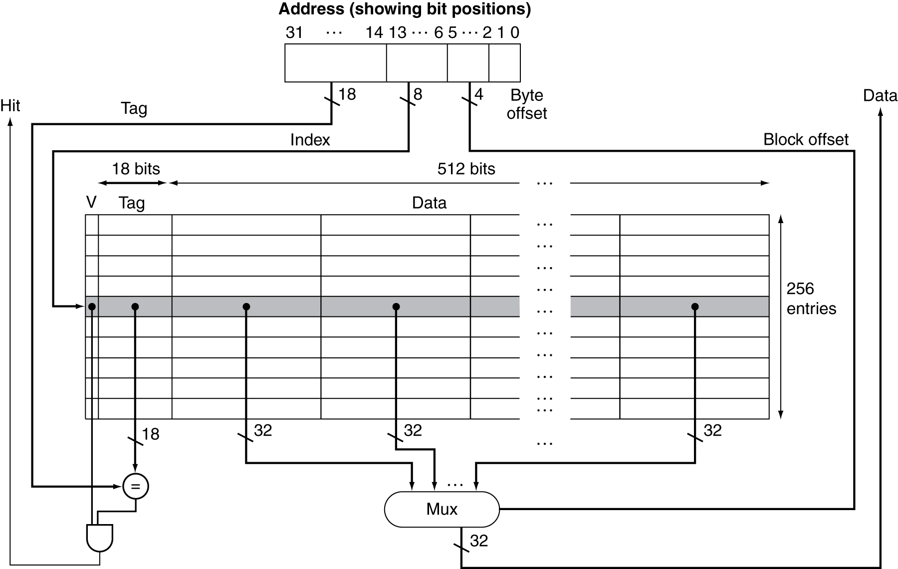
Example: Intrinsity FastMATH

Slide 24
Main Memory Supporting Caches
Use DRAMs for main memory
Fixed width (e.g., 1 word)
Connected by fixed-width clocked bus
Bus clock is typically slower than CPU clock
Example cache block read
1 bus cycle for address transfer
15 bus cycles per DRAM access
1 bus cycle per data transfer
For 4-word block, 1-word-wide DRAM
Miss penalty = 1 + 4×15 + 4×1 = 65 bus cycles
Bandwidth = 16 bytes / 65 cycles = 0.25 B/cycle

Slide 25
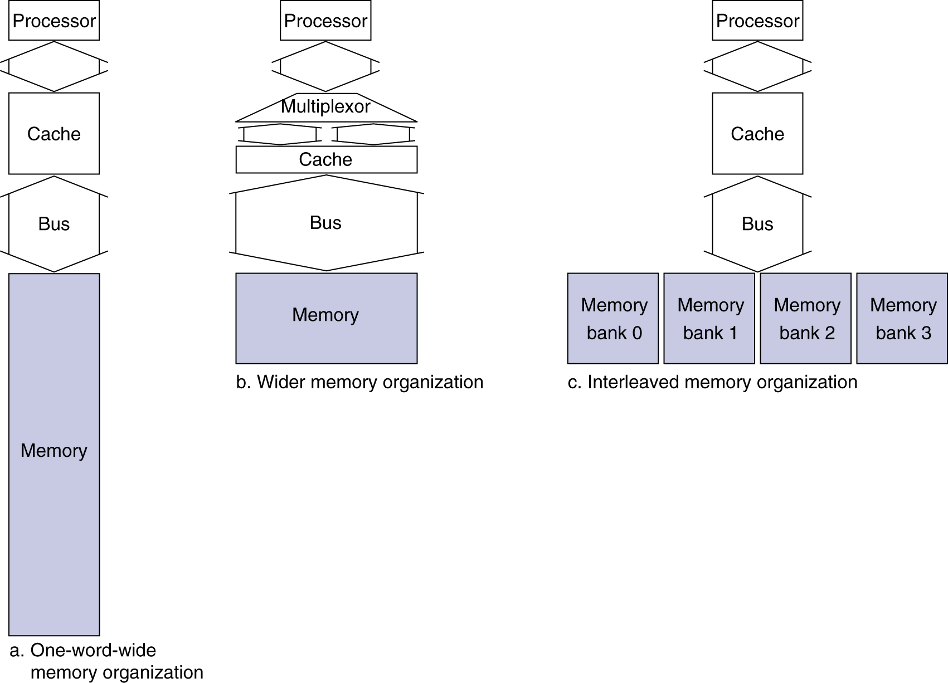
Increasing Memory Bandwidth
4-word wide memory
Miss penalty = 1 + 15 + 1 = 17 bus cycles
Bandwidth = 16 bytes / 17 cycles = 0.94 B/cycle
4-bank interleaved memory
Miss penalty = 1 + 15 + 4×1 = 20 bus cycles
Bandwidth = 16 bytes / 20 cycles = 0.8 B/cycle

Slide 26
Advanced DRAM Organization
Bits in a DRAM are organized as a rectangular array
DRAM accesses an entire row
Burst mode: supply successive words from a row with reduced latency
Double data rate (DDR) DRAM
Transfer on rising and falling clock edges
Quad data rate (QDR) DRAM
Separate DDR inputs and outputs

Slide 27
DRAM Generations
Year | Capacity | $/GB
1980 | 64Kbit | $1500000
1983 | 256Kbit | $500000
1985 | 1Mbit | $200000
1989 | 4Mbit | $50000
1992 | 16Mbit | $15000
1996 | 64Mbit | $10000
1998 | 128Mbit | $4000
2000 | 256Mbit | $1000
2004 | 512Mbit | $250
2007 | 1Gbit | $50

Slide 28
Measuring Cache Performance
Components of CPU time
Program execution cycles
Includes cache hit time
Memory stall cycles
Mainly from cache misses
With simplifying assumptions:
§5.3 Measuring and Improving Cache Performance

Slide 29
Cache Performance Example
Given
I-cache miss rate = 2%
D-cache miss rate = 4%
Miss penalty = 100 cycles
Base CPI (ideal cache) = 2
Load & stores are 36% of instructions
Miss cycles per instruction
I-cache: 0.02 × 100 = 2
D-cache: 0.36 × 0.04 × 100 = 1.44
Actual CPI = 2 + 2 + 1.44 = 5.44
Ideal CPU is 5.44/2 =2.72 times faster

Slide 30
Average Access Time
Hit time is also important for performance
Average memory access time (AMAT)
AMAT = Hit time + Miss rate × Miss penalty
Example
CPU with 1ns clock, hit time = 1 cycle, miss penalty = 20 cycles, I-cache miss rate = 5%
AMAT = 1 + 0.05 × 20 = 2ns
2 cycles per instruction

Slide 31
Performance Summary
When CPU performance increased
Miss penalty becomes more significant
Decreasing base CPI
Greater proportion of time spent on memory stalls
Increasing clock rate
Memory stalls account for more CPU cycles
Can’t neglect cache behavior when evaluating system performance

Slide 32
Associative Caches
Fully associative
Allow a given block to go in any cache entry
Requires all entries to be searched at once
Comparator per entry (expensive)
n-way set associative
Each set contains n entries
Block number determines which set
(Block number) modulo (#Sets in cache)
Search all entries in a given set at once
n comparators (less expensive)

Slide 33
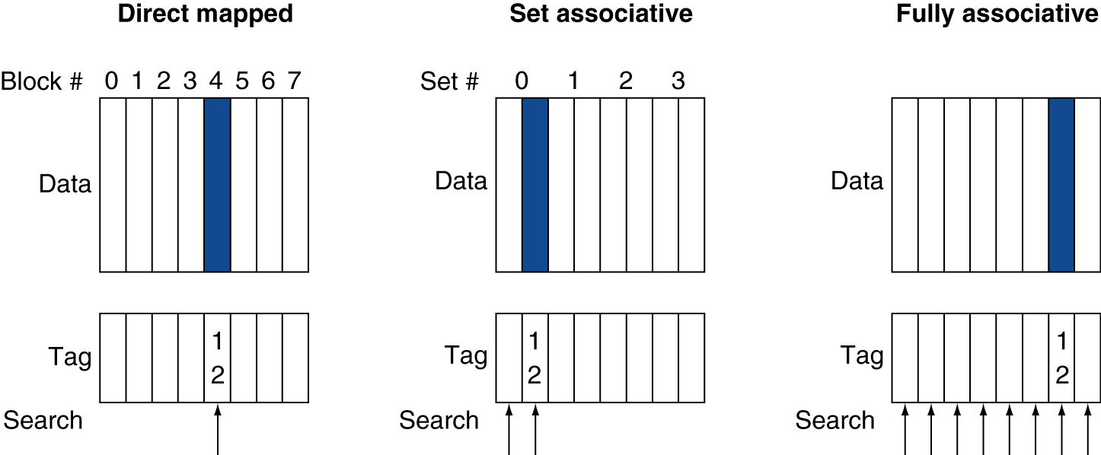
Associative Cache Example

Slide 34
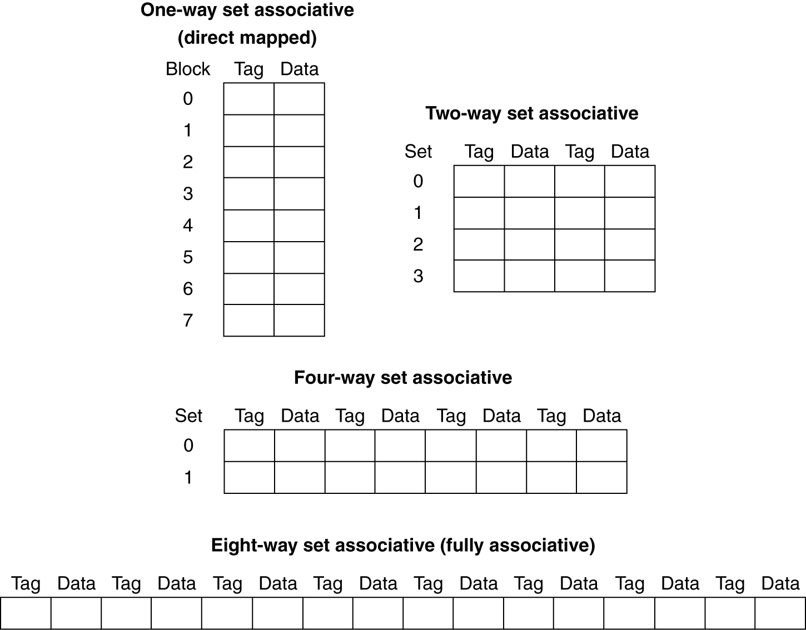
Spectrum of Associativity
For a cache with 8 entries

Slide 35
Associativity Example
Compare 4-block caches
Direct mapped, 2-way set associative, fully associative
Block access sequence: 0, 8, 0, 6, 8
Direct mapped
Block address | Cache index | Hit/miss | Cache content after access
 |  |  | 0 | 1 | 2 | 3
0 | 0 | miss | Mem[0]
8 | 0 | miss | Mem[8]
0 | 0 | miss | Mem[0]
6 | 2 | miss | Mem[0] |  | Mem[6]
8 | 0 | miss | Mem[8] |  | Mem[6]

Slide 36
Associativity Example
2-way set associative
Block address | Cache index | Hit/miss | Cache content after access
 |  |  | Set 0 |  | Set 1
0 | 0 | miss | Mem[0]
8 | 0 | miss | Mem[0] | Mem[8]
0 | 0 | hit | Mem[0] | Mem[8]
6 | 0 | miss | Mem[0] | Mem[6]
8 | 0 | miss | Mem[8] | Mem[6]
Fully associative
Block address |  | Hit/miss | Cache content after access
0 |  | miss | Mem[0]
8 |  | miss | Mem[0] | Mem[8]
0 |  | hit | Mem[0] | Mem[8]
6 |  | miss | Mem[0] | Mem[8] | Mem[6]
8 |  | hit | Mem[0] | Mem[8] | Mem[6]

Slide 37
How Much Associativity
Increased associativity decreases miss rate
But with diminishing returns
Simulation of a system with 64KB D-cache, 16-word blocks, SPEC2000
1-way: 10.3%
2-way: 8.6%
4-way: 8.3%
8-way: 8.1%

Slide 38
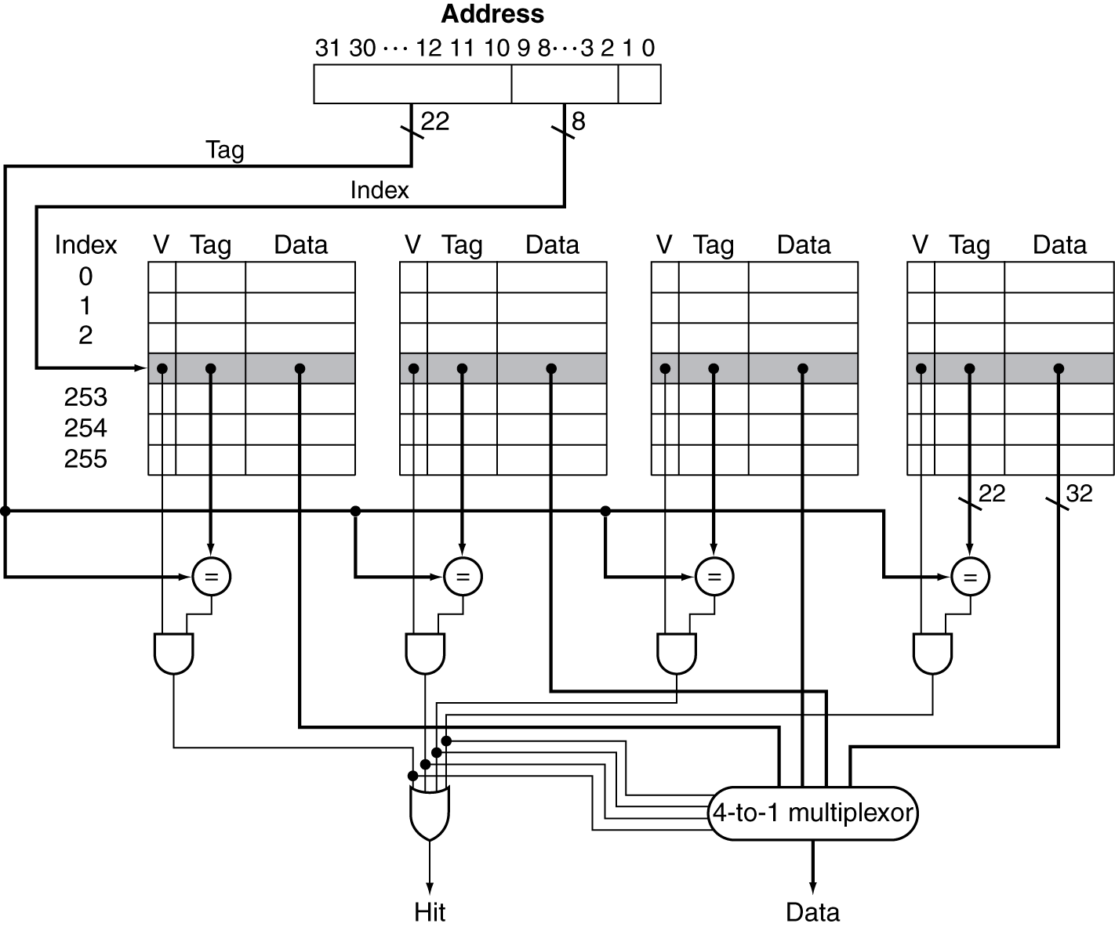
Set Associative Cache Organization

Slide 39
Replacement Policy
Direct mapped: no choice
Set associative
Prefer non-valid entry, if there is one
Otherwise, choose among entries in the set
Least-recently used (LRU)
Choose the one unused for the longest time
Simple for 2-way, manageable for 4-way, too hard beyond that
Random
Gives approximately the same performance as LRU for high associativity

Slide 40
Multilevel Caches
Primary cache attached to CPU
Small, but fast
Level-2 cache services misses from primary cache
Larger, slower, but still faster than main memory
Main memory services L-2 cache misses
Some high-end systems include L-3 cache

Slide 41
Multilevel Cache Example
Given
CPU base CPI = 1, clock rate = 4GHz
Miss rate/instruction = 2%
Main memory access time = 100ns
With just primary cache
Miss penalty = 100ns/0.25ns = 400 cycles
Effective CPI = 1 + 0.02 × 400 = 9

Slide 42
Example (cont.)
Now add L-2 cache
Access time = 5ns
Global miss rate to main memory = 0.5%
Primary miss with L-2 hit
Penalty = 5ns/0.25ns = 20 cycles
Primary miss with L-2 miss
Extra penalty = 400 cycles
CPI = 1 + 0.02 × 20 + 0.005 × 400 = 3.4
Performance ratio = 9/3.4 = 2.6

Slide 43
Multilevel Cache Considerations
Primary cache
Focus on minimal hit time
L-2 cache
Focus on low miss rate to avoid main memory access
Hit time has less overall impact
Results
L-1 cache usually smaller than a single cache
L-1 block size smaller than L-2 block size

Slide 44
Interactions with Advanced CPUs
Out-of-order CPUs can execute instructions during cache miss
Pending store stays in load/store unit
Dependent instructions wait in reservation stations
Independent instructions continue
Effect of miss depends on program data flow
Much harder to analyse
Use system simulation

Slide 45
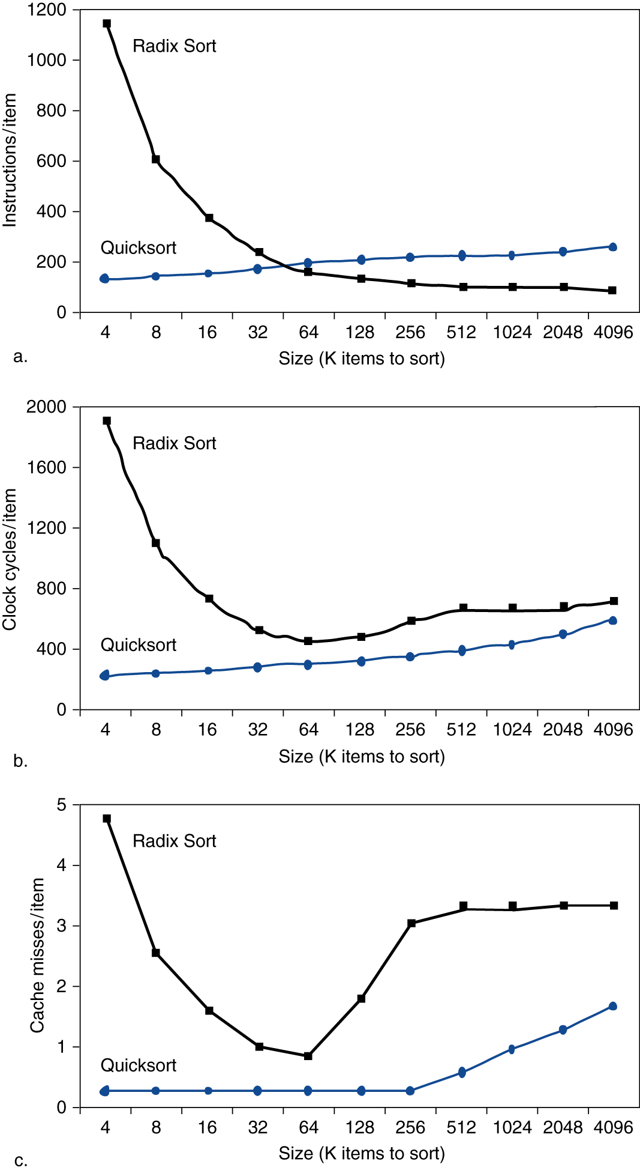
Interactions with Software
Misses depend on memory access patterns
Algorithm behavior
Compiler optimization for memory access

Slide 46
Sources of Misses
Compulsory misses (aka cold start misses)
First access to a block
Capacity misses
Due to finite cache size
A replaced block is later accessed again
Conflict misses (aka collision misses)
In a non-fully associative cache
Due to competition for entries in a set
Would not occur in a fully associative cache of the same total size

Slide 47
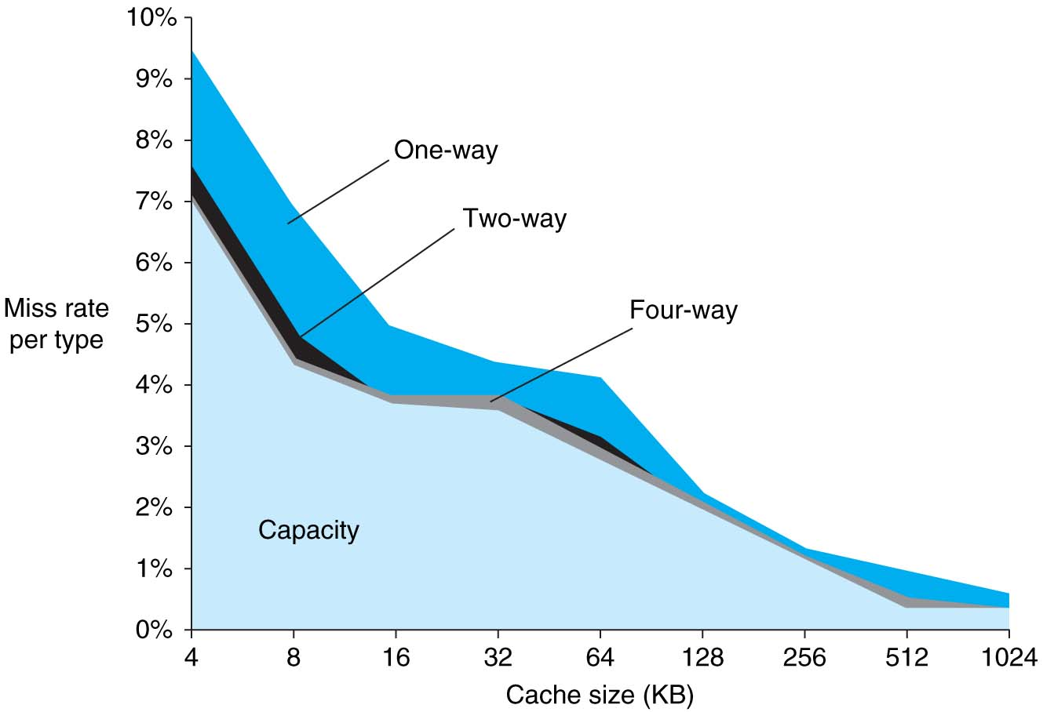
FIGURE 5.31 The miss rate can be broken into three sources of misses. This graph shows the total miss rate and its components for a range of cache sizes. This data is for the SPEC2000 integer and floating-point benchmarks and is from the same source as the data in Figure 5.30. The compulsory miss component is 0.006% and cannot be seen in this graph. The next component is the capacity miss rate, which depends on cache size. The conflict portion, which depends both on associativity and on cache size, is shown for a range of associativities from one-way to eight-way. In each case, the labeled section corresponds to the increase in the miss rate that occurs when the associativity is changed from the next higher degree to the labeled degree of associativity. For example, the section labeled two-way indicates the additional misses arising when the cache has associativity of two rather than four. Thus, the difference in the miss rate incurred by a direct-mapped cache versus a fully associative cache of the same size is given by the sum of the sections
marked eight-way, four-way, two-way, and one-way. The difference between eight-way and four-way is so small that it is diffi cult to see on this graph. Copyright © 2009 Elsevier, Inc. All rights reserved.

Slide 48
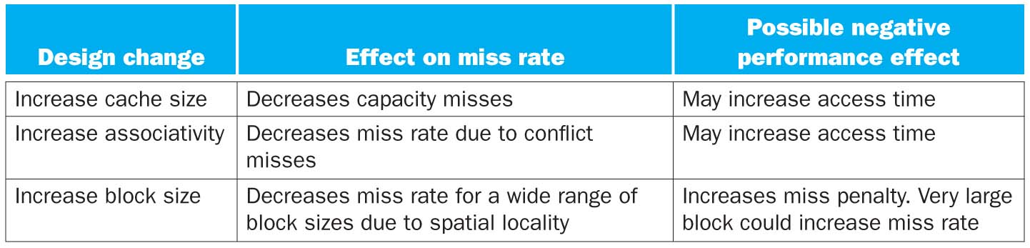
Cache Design Trade-offs
FIGURE 5.32 Memory hierarchy design challenges. Copyright © 2009 Elsevier, Inc. All rights reserved.

Slide 49
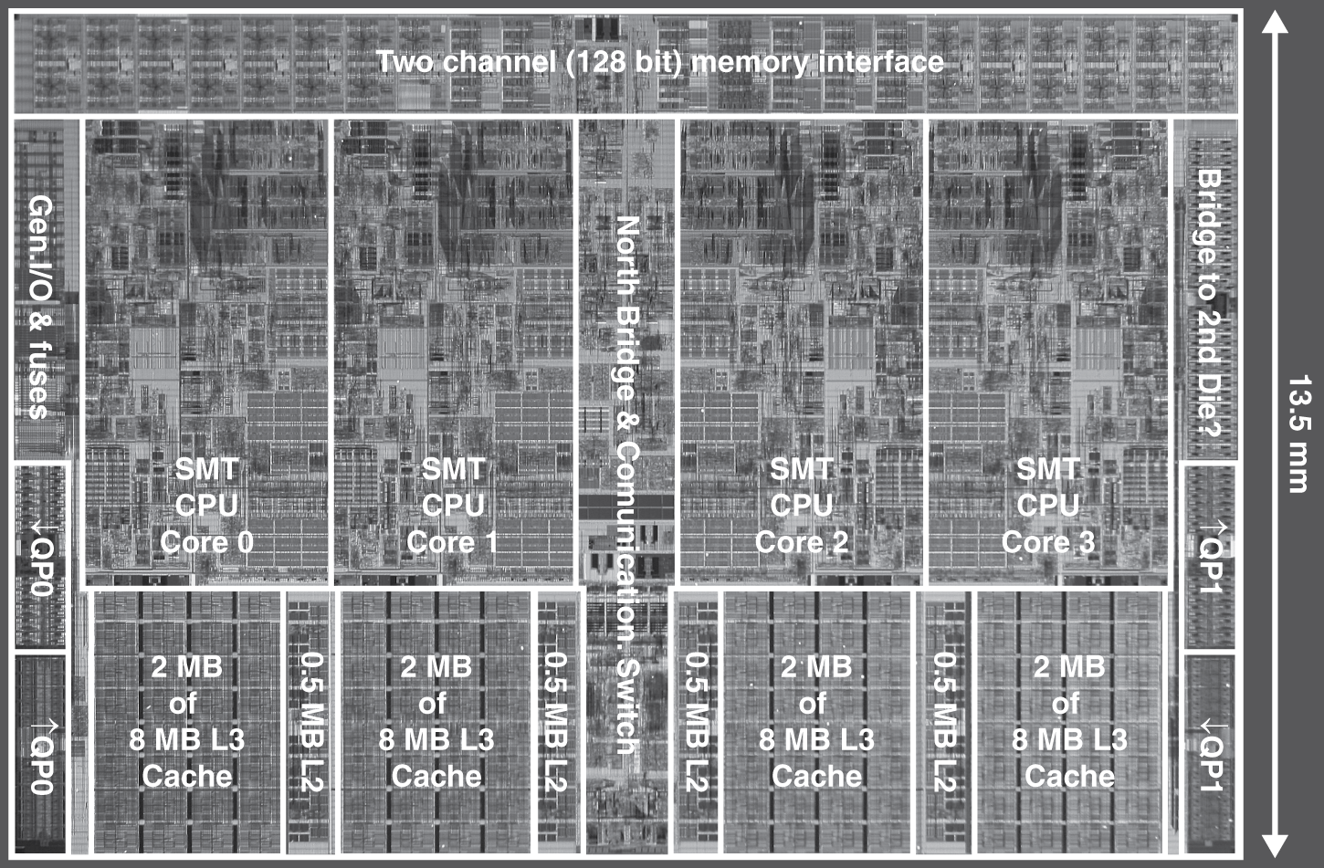
Multilevel On-Chip Caches
Intel Nehalem 4-core processor
§5.10 Real Stuff: The AMD Opteron X4 and Intel Nehalem
Per core: 32KB L1 I-cache, 32KB L1 D-cache, 512KB L2 cache

Slide 50
3-Level Cache Organization
 | Intel Nehalem | AMD Opteron X4
L1 caches (per core) | L1 I-cache: 32KB, 64-byte blocks, 4-way, approx LRU replacement, hit time n/a L1 D-cache: 32KB, 64-byte blocks, 8-way, approx LRU replacement, write-back/allocate, hit time n/a | L1 I-cache: 32KB, 64-byte blocks, 2-way, LRU replacement, hit time 3 cycles L1 D-cache: 32KB, 64-byte blocks, 2-way, LRU replacement, write-back/allocate, hit time 9 cycles
L2 unified cache (per core) | 256KB, 64-byte blocks, 8-way, approx LRU replacement, write-back/allocate, hit time n/a | 512KB, 64-byte blocks, 16-way, approx LRU replacement, write-back/allocate, hit time n/a
L3 unified cache (shared) | 8MB, 64-byte blocks, 16-way, replacement n/a, write-back/allocate, hit time n/a | 2MB, 64-byte blocks, 32-way, replace block shared by fewest cores, write-back/allocate, hit time 32 cycles
n/a: data not available

Slide 51
Mis Penalty Reduction
Return requested word first
Then back-fill rest of block
Non-blocking miss processing
Hit under miss: allow hits to proceed
Mis under miss: allow multiple outstanding misses
Hardware prefetch: instructions and data
Opteron X4: bank interleaved L1 D-cache
Two concurrent accesses per cycle

Slide 52
Virtual Memory
§5.4 Virtual Memory
Use main memory as a “cache” for secondary (disk) storage
Managed jointly by CPU hardware and the operating system (OS)
Programs share main memory
Each gets a private virtual address space holding its frequently used code and data
Protected from other programs
CPU and OS translate virtual addresses to physical addresses
VM “block” is called a page
VM translation “miss” is called a page fault

Slide 53
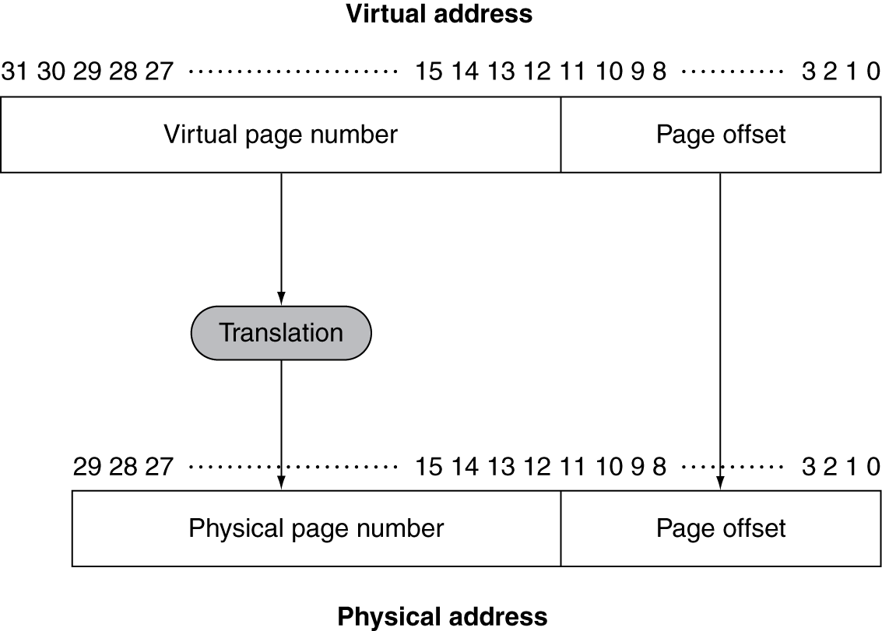
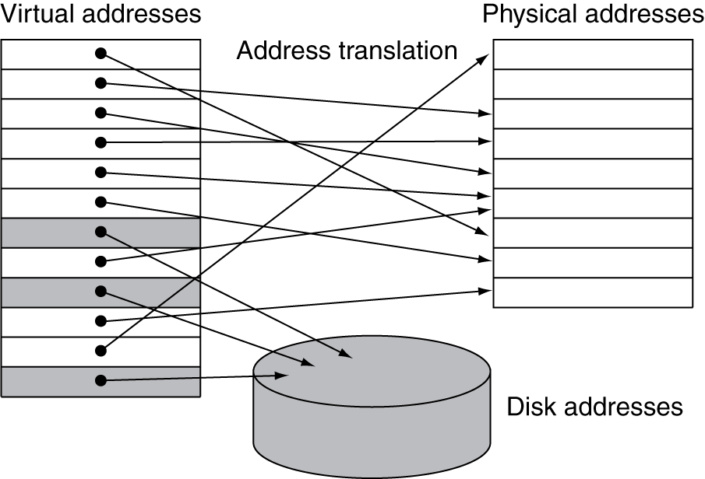
Address Translation
Fixed-size pages (e.g., 4K)

Slide 54
Page Fault Penalty
On page fault, the page must be fetched from disk
Takes millions of clock cycles
Handled by OS code
Try to minimize page fault rate
Fully associative placement
Smart replacement algorithms

Slide 55
Page Tables
Stores placement information
Array of page table entries, indexed by virtual page number
Page table register in CPU points to page table in physical memory
If page is present in memory
PTE stores the physical page number
Plus other status bits (referenced, dirty, …)
If page is not present
PTE can refer to location in swap space on disk

Slide 56
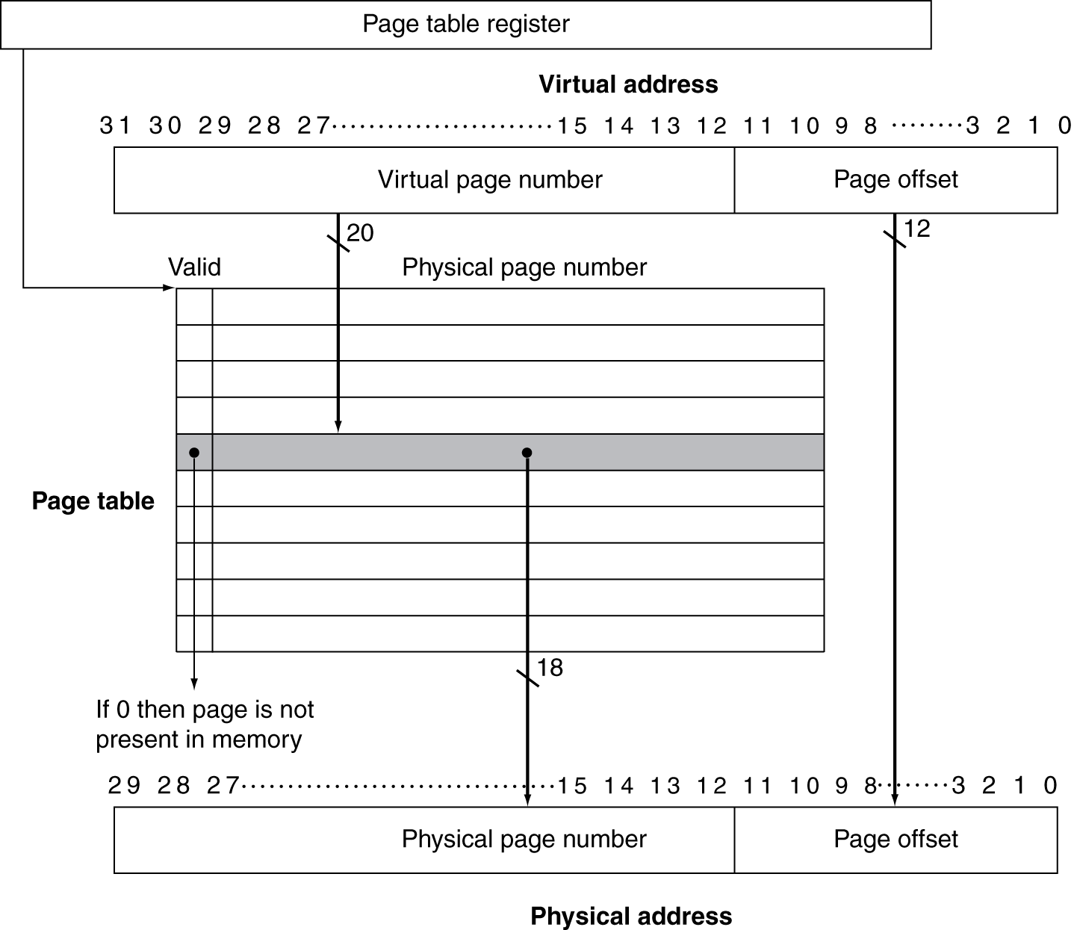
Translation Using a Page Table

Slide 57
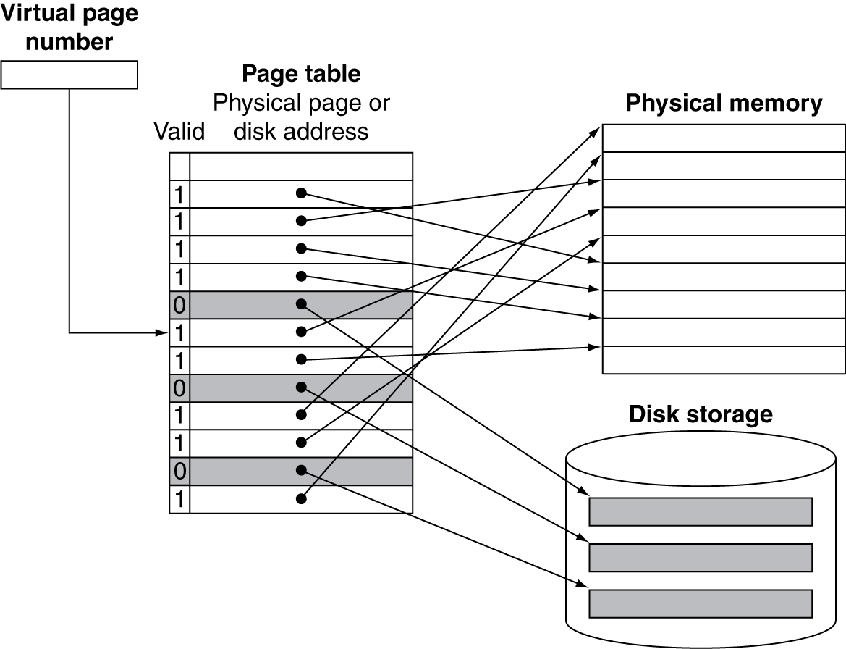
Mapping Pages to Storage

Slide 58
Replacement and Writes
To reduce page fault rate, prefer least-recently used (LRU) replacement
Reference bit (aka use bit) in PTE set to 1 on access to page
Periodically cleared to 0 by OS
A page with reference bit = 0 has not been used recently
Disk writes take millions of cycles
Block at once, not individual locations
Write through is impractical
Use write-back
Dirty bit in PTE set when page is written

Slide 59
Fast Translation Using a TLB
Address translation would appear to require extra memory references
One to access the PTE
Then the actual memory access
But access to page tables has good locality
So use a fast cache of PTEs within the CPU
Called a Translation Look-aside Buffer (TLB)
Typical: 16–512 PTEs, 0.5–1 cycle for hit, 10–100 cycles for miss, 0.01%–1% miss rate
Misses could be handled by hardware or software

Slide 60
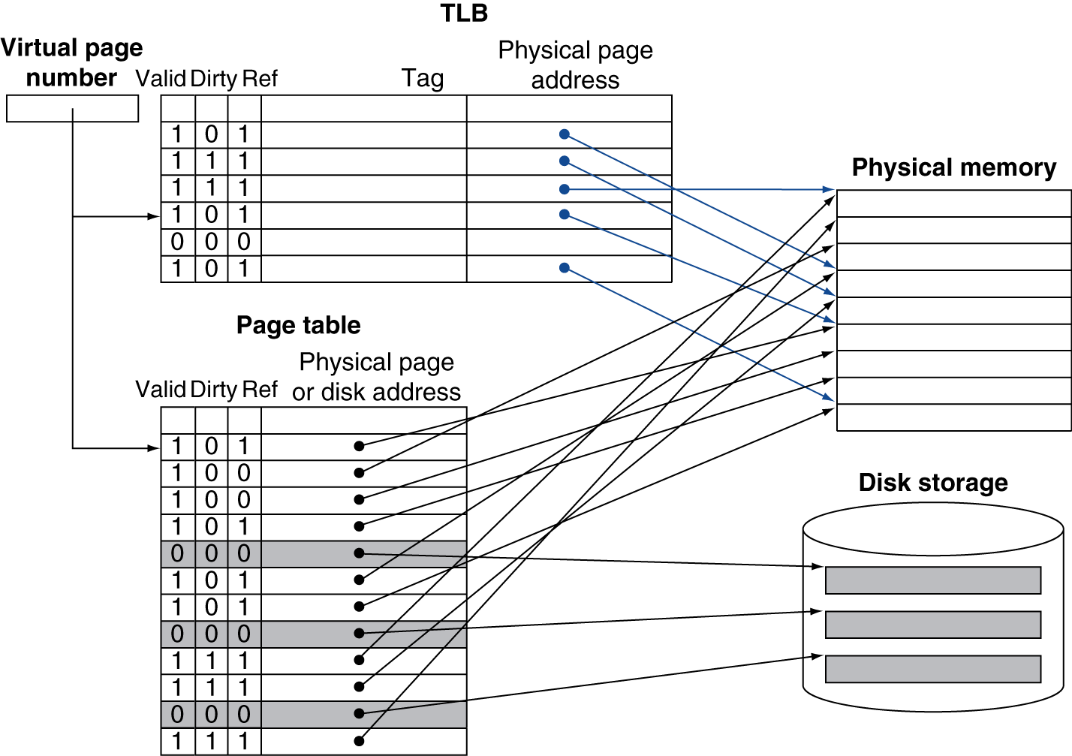
Fast Translation Using a TLB

Slide 61
TLB Misses
If page is in memory
Load the PTE from memory and retry
Could be handled in hardware
Can get complex for more complicated page table structures
Or in software
Raise a special exception, with optimized handler
If page is not in memory (page fault)
OS handles fetching the page and updating the page table
Then restart the faulting instruction

Slide 62
TLB Miss Handler
TLB miss indicates
Page present, but PTE not in TLB
Page not preset
Must recognize TLB miss before destination register overwritten
Raise exception
Handler copies PTE from memory to TLB
Then restarts instruction
If page not present, page fault will occur

Slide 63
Page Fault Handler
Use faulting virtual address to find PTE
Locate page on disk
Choose page to replace
If dirty, write to disk first
Read page into memory and update page table
Make process runnable again
Restart from faulting instruction

Slide 64
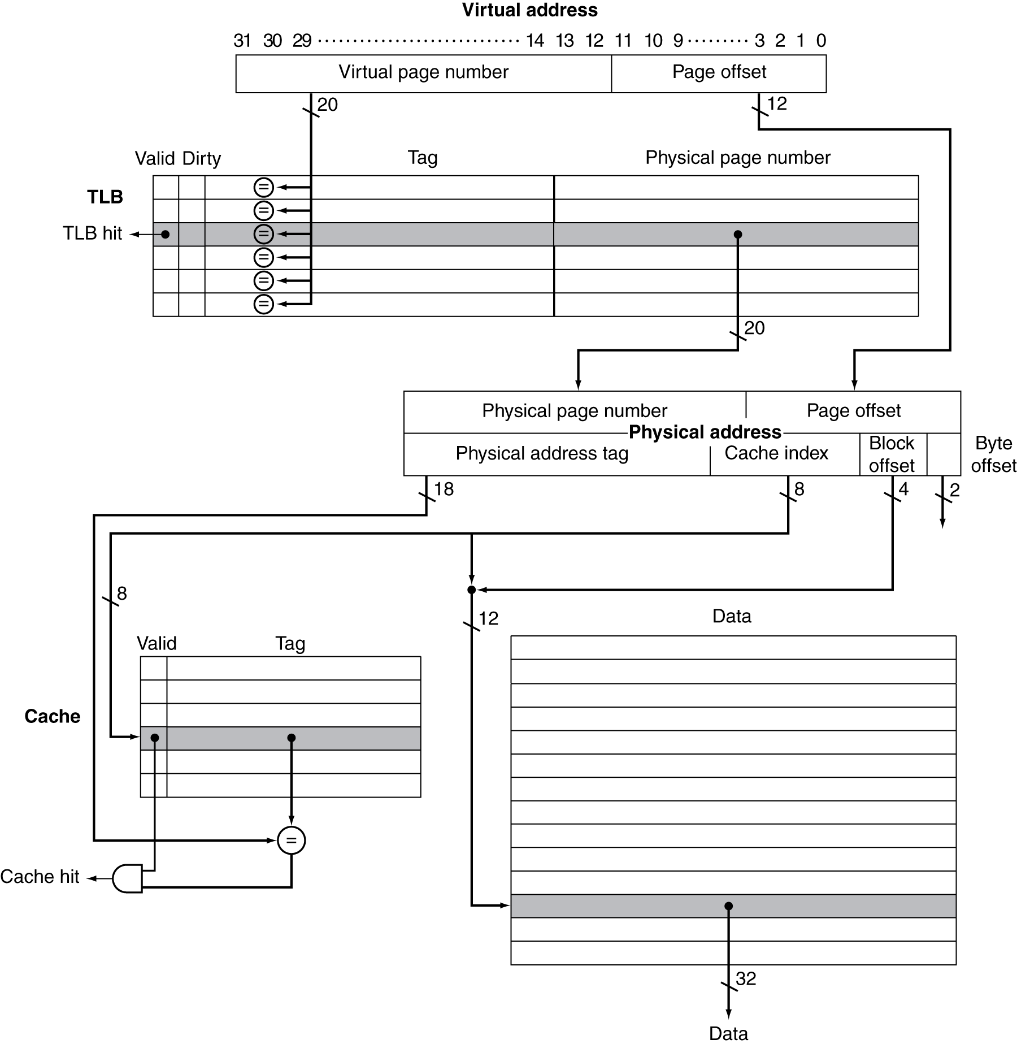
TLB and Cache Interaction
If cache tag uses physical address
Need to translate before cache lookup
Alternative: use virtual address tag
Complications due to aliasing
Different virtual addresses for shared physical address

Slide 65
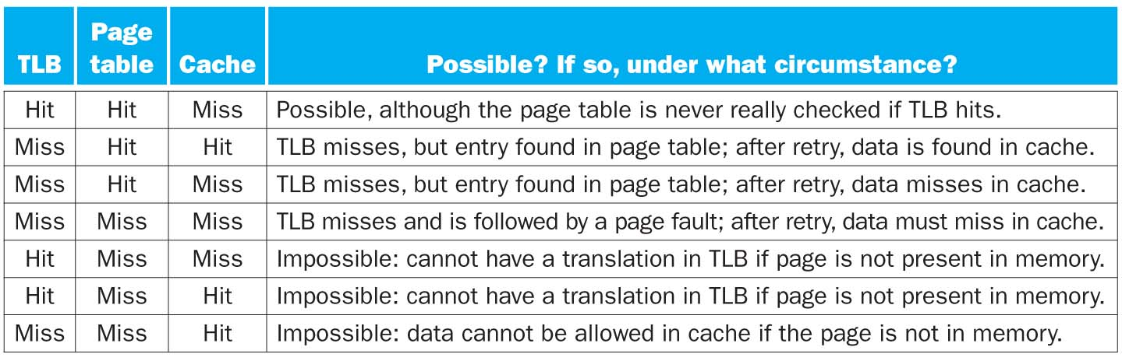
FIGURE 5.26 The possible combinations of events in the TLB, virtual memory system, and cache. Three of these combinations are impossible, and one is possible (TLB hit, virtual memory hit, cache miss) but never detected. Copyright © 2009 Elsevier, Inc. All rights reserved.

Slide 66
Memory Protection
Different tasks can share parts of their virtual address spaces
But need to protect against errant access
Requires OS assistance
Hardware support for OS protection
Privileged supervisor mode (aka kernel mode)
Privileged instructions
Page tables and other state information only accessible in supervisor mode
System call exception (e.g., syscall in MIPS)

Slide 67
The Memory Hierarchy
The BIG Picture
Common principles apply at all levels of the memory hierarchy
Based on notions of caching
At each level in the hierarchy
Block placement
Finding a block
Replacement on a miss
Write policy
§5.5 A Common Framework for Memory Hierarchies

Slide 68
Block Placement
Determined by associativity
Direct mapped (1-way associative)
One choice for placement
n-way set associative
n choices within a set
Fully associative
Any location
Higher associativity reduces miss rate
Increases complexity, cost, and access time

Slide 69
Finding a Block
Associativity | Location method | Tag comparisons
Direct mapped | Index | 1
n-way set associative | Set index, then search entries within the set | n
Fully associative | Search all entries | #entries
 | Full lookup table | 0
Hardware caches
Reduce comparisons to reduce cost
Virtual memory
Full table lookup makes full associativity feasible
Benefit in reduced miss rate

Slide 70
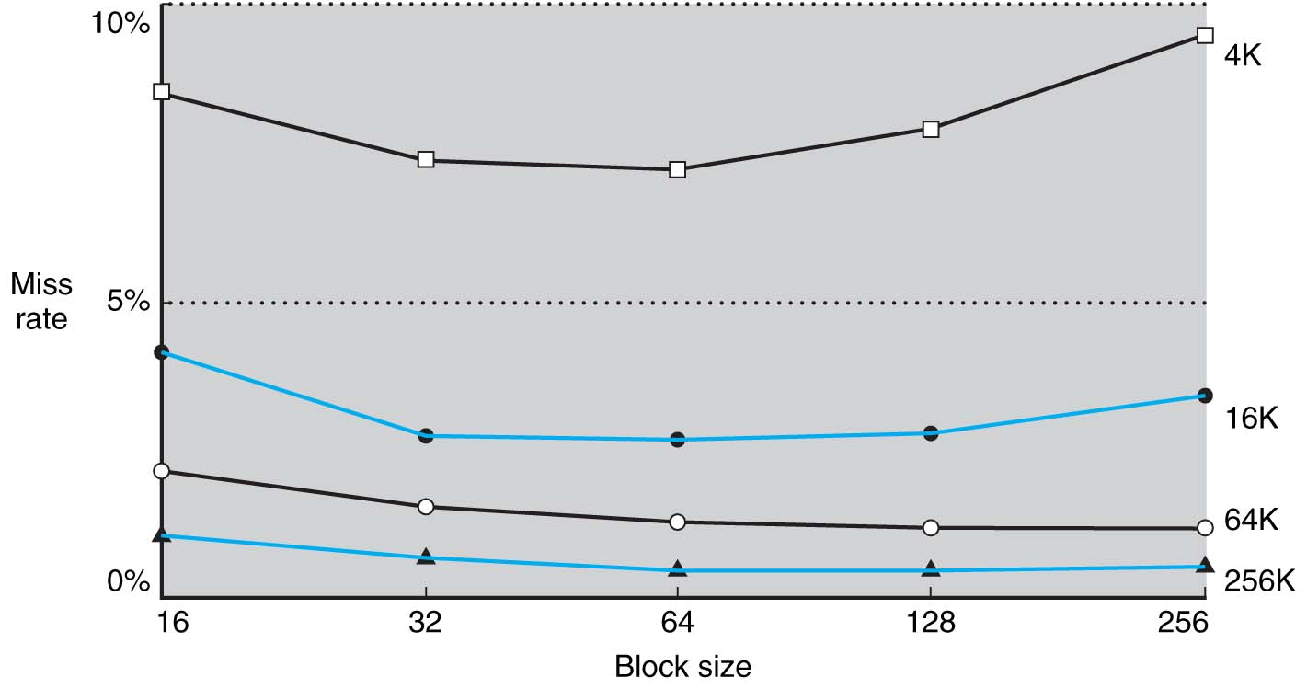
FIGURE 5.8 Miss rate versus block size. Note that the miss rate actually goes up if the block size is too large relative to the cache size. Each line represents a cache of different size. (This figure is independent of associativity, discussed soon.) Unfortunately, SPEC2000 traces would take too long if block size were included, so this data is based on SPEC92. Copyright © 2009 Elsevier, Inc. All rights reserved.

Slide 71
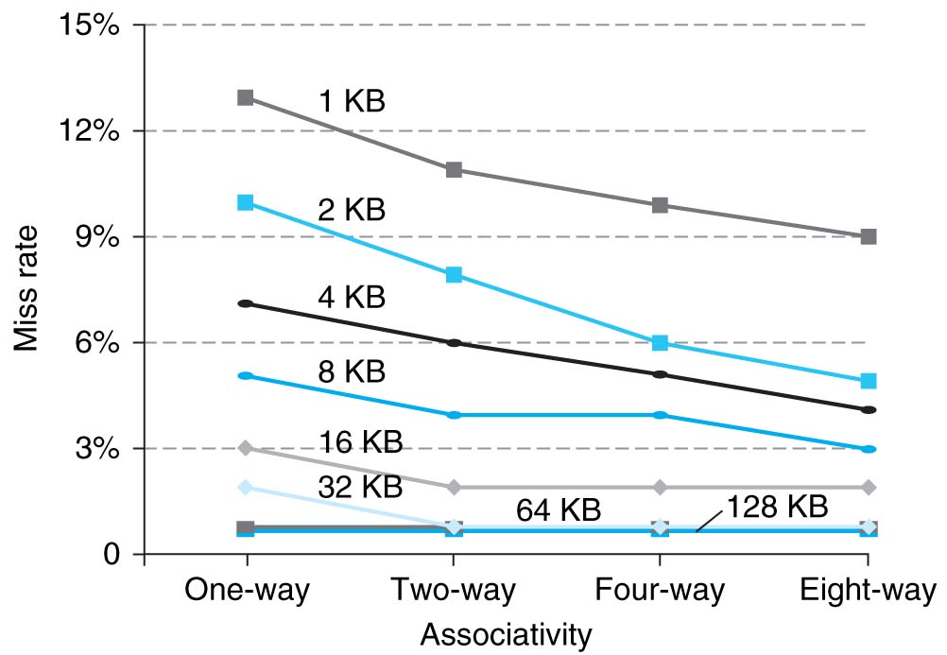
FIGURE 5.30 The data cache miss rates for each of eight cache sizes improve as the associativity increases. While the benefit of going from one-way (direct mapped) to two-way set associative is significant, the benefits of further associativity are smaller (e.g., 1%–10% improvement going from two-way to four-way versus 20%–30% improvement going from one-way to two-way). There is even less improvement in going from four-way to eight-way set associative, which, in turn, comes very close to the miss rates of a fully associative cache. Smaller caches obtain a significantly larger absolute benefit from associativity because the base miss rate of a small cache is larger. Figure 5.15 explains how this data was collected. Copyright © 2009 Elsevier, Inc. All rights reserved.

Slide 72
Replacement
Choice of entry to replace on a miss
Least recently used (LRU)
Complex and costly hardware for high associativity
Random
Close to LRU, easier to implement
Virtual memory
LRU approximation with hardware support

Slide 73
Write Policy
Write-through
Update both upper and lower levels
Simplifies replacement, but may require write buffer
Write-back
Update upper level only
Update lower level when block is replaced
Need to keep more state
Virtual memory
Only write-back is feasible, given disk write latency

Slide 74
2-Level TLB Organization
 | Intel Nehalem | AMD Opteron X4
Virtual addr | 48 bits | 48 bits
Physical addr | 44 bits | 48 bits
Page size | 4KB, 2/4MB | 4KB, 2/4MB
L1 TLB (per core) | L1 I-TLB: 128 entries for small pages, 7 per thread (2×) for large pages L1 D-TLB: 64 entries for small pages, 32 for large pages Both 4-way, LRU replacement | L1 I-TLB: 48 entries L1 D-TLB: 48 entries Both fully associative, LRU replacement
L2 TLB (per core) | Single L2 TLB: 512 entries 4-way, LRU replacement | L2 I-TLB: 512 entries L2 D-TLB: 512 entries Both 4-way, round-robin LRU
TLB misses | Handled in hardware | Handled in hardware

Slide 75
Concluding Remarks
Fast memories are small, large memories are slow
We really want fast, large memories ☹
Caching gives this illusion ☺
Principle of locality
Programs use a small part of their memory space frequently
Memory hierarchy
L1 cache ↔ L2 cache ↔ … ↔ DRAM memory ↔ disk
Memory system design is critical for multiprocessors
§5.12 Concluding Remarks

